Slide 1

ACME Talks

Slide 2
Agenda
History, Bluetooth vs Bluetooth Smart (Bluetooth Low Energy)
Bluetooth Smart Ready
Protocol Basics

Slide 3
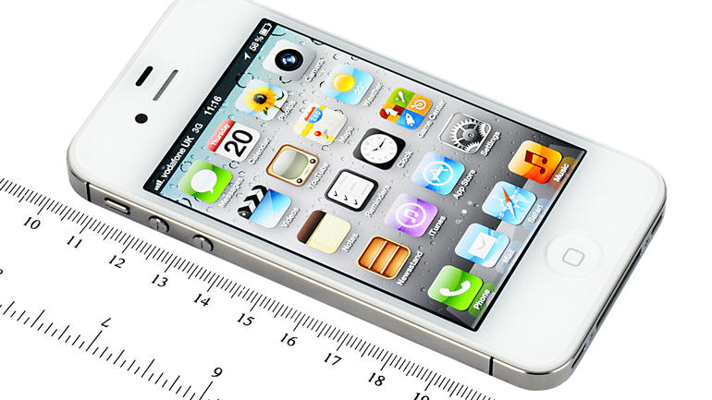
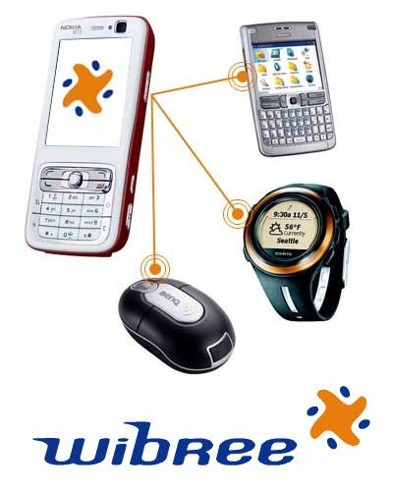
History
Introduced by Nokia in 2006
named Wibree / Baby Bluetooth
Merged into the main Bluetooth standard in 2010
Bluetooth Core Specification Version 4.0
The Bluetooth SIG predicts: by 2018 more than 90 percent of Bluetooth-enabled smartphones will support Bluetooth Smart
The first cell phone to feature Bluetooth 4.0: iPhone 4S

Slide 4
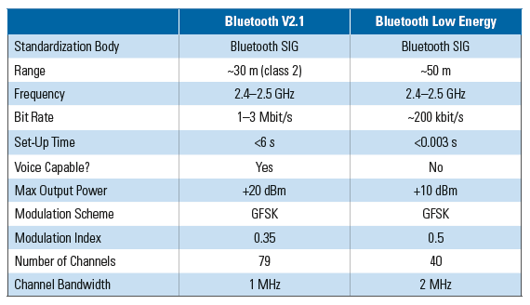
Bluetooth vs Bluetooth Smart

Slide 5
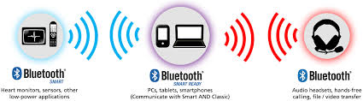
Bluetooth Smart Ready
Single-mode: BLE, Bluetooth Smart devices
ex. a heart rate sensor
Dual-mode: Bluetooth Smart Ready devices
include both Bluetooth low energy and Classic Bluetooth
ex. a smartphone or PC
fundamentally different technologies from an application perspective

Slide 6
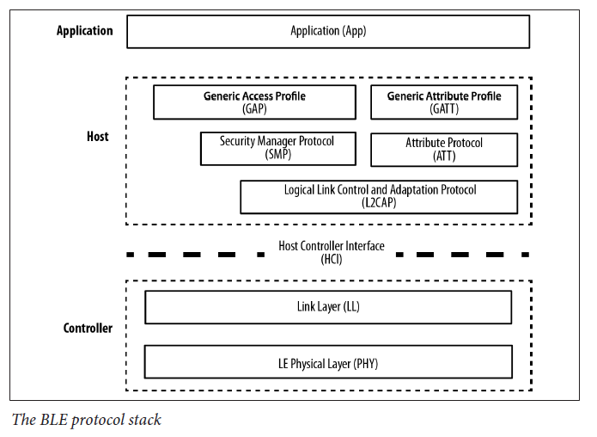
Protocol Basics

Slide 7
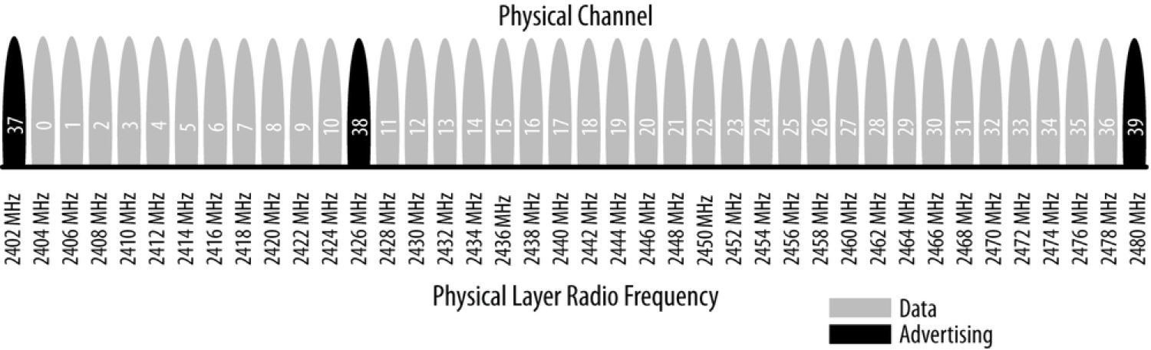
Physical Layer
Contains analog communications circuitry
2.4 GHz ISM (Industrial, Scientific, and Medical) band
divided into 40 channels (37 connection and 3 advertising channels)
Frequency hopping spread spectrum
a concept for having wireless radio signals switch quickly among many different frequency channels
minimizes the effect of any radio interference
Hedy Lamarr
Gaussian Frequency Shift Keying (GFSK) modulation

Slide 8
Link Layer
When not in an active connection
Advertiser
A device sending advertising packets
Scanner
A device scanning for advertising packets
When in a connection
Master
A device that initiates a connection and manages it later
Slave
A device that accepts a connection request and follows the master’s timing

Slide 9
Host Controller Interface
Separates Host from Controller
Allows them to communicate across a serial interface
A set of commands and events for the host and the controller to interact with each other, along with a data packet format and a set of rules for flow control and other procedures

Slide 10
Logical Link Control and Adaptation Protocol
Protocol multiplexer
encapsulates multiple protocols from the upper layers into the standard BLE packet format (and vice versa)
Performs fragmentation and recombination
breaks up into chunks large packets from the upper layers to fit the 27-byte maximum payload size of the BLE packets (on the transmit side, and the opposite on the reception side)

Slide 11
Attribute Protocol
Simple client/server stateless protocol based on attributes, each of which is assigned
a 16-bit attribute handle,
a universally unique identifier (UUID),
a set of permissions, and finally, of course,
a value
Each device is a client, a server, or both, irrespective of whether it’s a master or slave
A client requests data from a server, a server sends data to clients

Slide 12
Security Manager
Both a protocol and a series of security algorithms
Generate and exchange security keys, which then allow secure communication over an encrypted link, to trust the identity of the remote device, and finally, to hide the public Bluetooth Address if required
Defines two roles:
Initiator
Always corresponds to the Link Layer master and therefore the GAP central
Responder
Always corresponds to the Link Layer slave and therefore the GAP peripheral

Slide 13
Generic Access Profile (1/2)
Provides a framework that any BLE implementation must follow
Makes your device visible to the outside world, and determines how two devices can('t) interact with each other
Specifies four roles that a device can adopt to join a BLE network

Slide 14
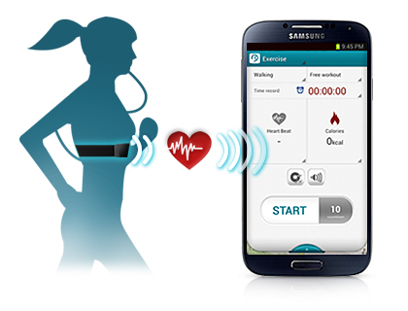
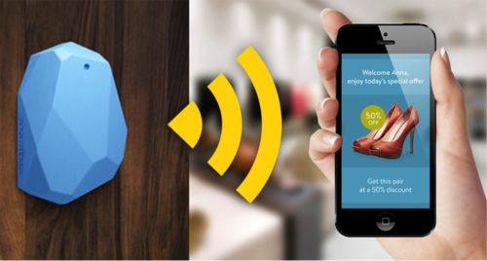
Generic Access Profile (2/2)
Broadcaster (Optimized for transmit-only applications)
Periodically sends out advertising packets with data
Observer (Optimized for receive-only applications)
Listens for data embedded in advertising packets from broadcasting peers
Central (corresponds to the Link Layer master)
always the initiator of connections
essentially allows devices onto the network
Peripheral (corresponds to the Link Layer slave)
uses advertising packets to allow centrals to find it and, subsequently, to establish a connection with it

Slide 15
Generic Attribute Profile
Key section of the BLE specification
every single item of data relevant to applications and users must be formatted, packed, and sent according to its rules
Adds a hierarchy and data abstraction model on top of ATT
Defines how data is organized and exchanged between applications
Maintains the same client/server architecture as ATT, but the data is now encapsulated in services, which consist of one or more characteristics, which can include one or more descriptors

Slide 16
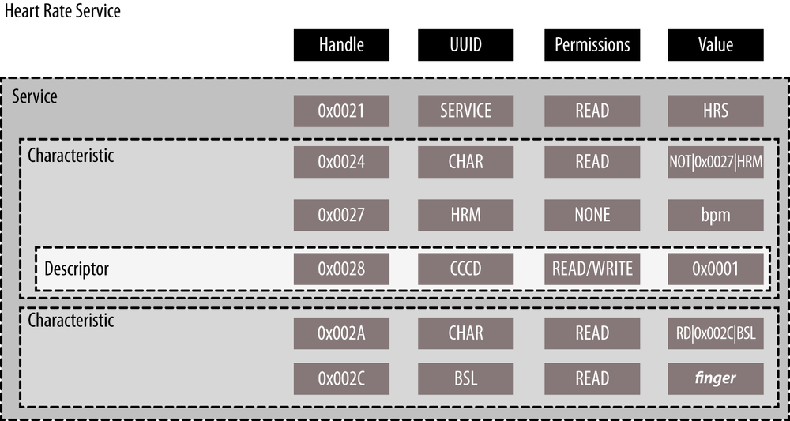
GATT Heart Rate Service

Slide 17
Q & A
Thank you!

